Slide 1
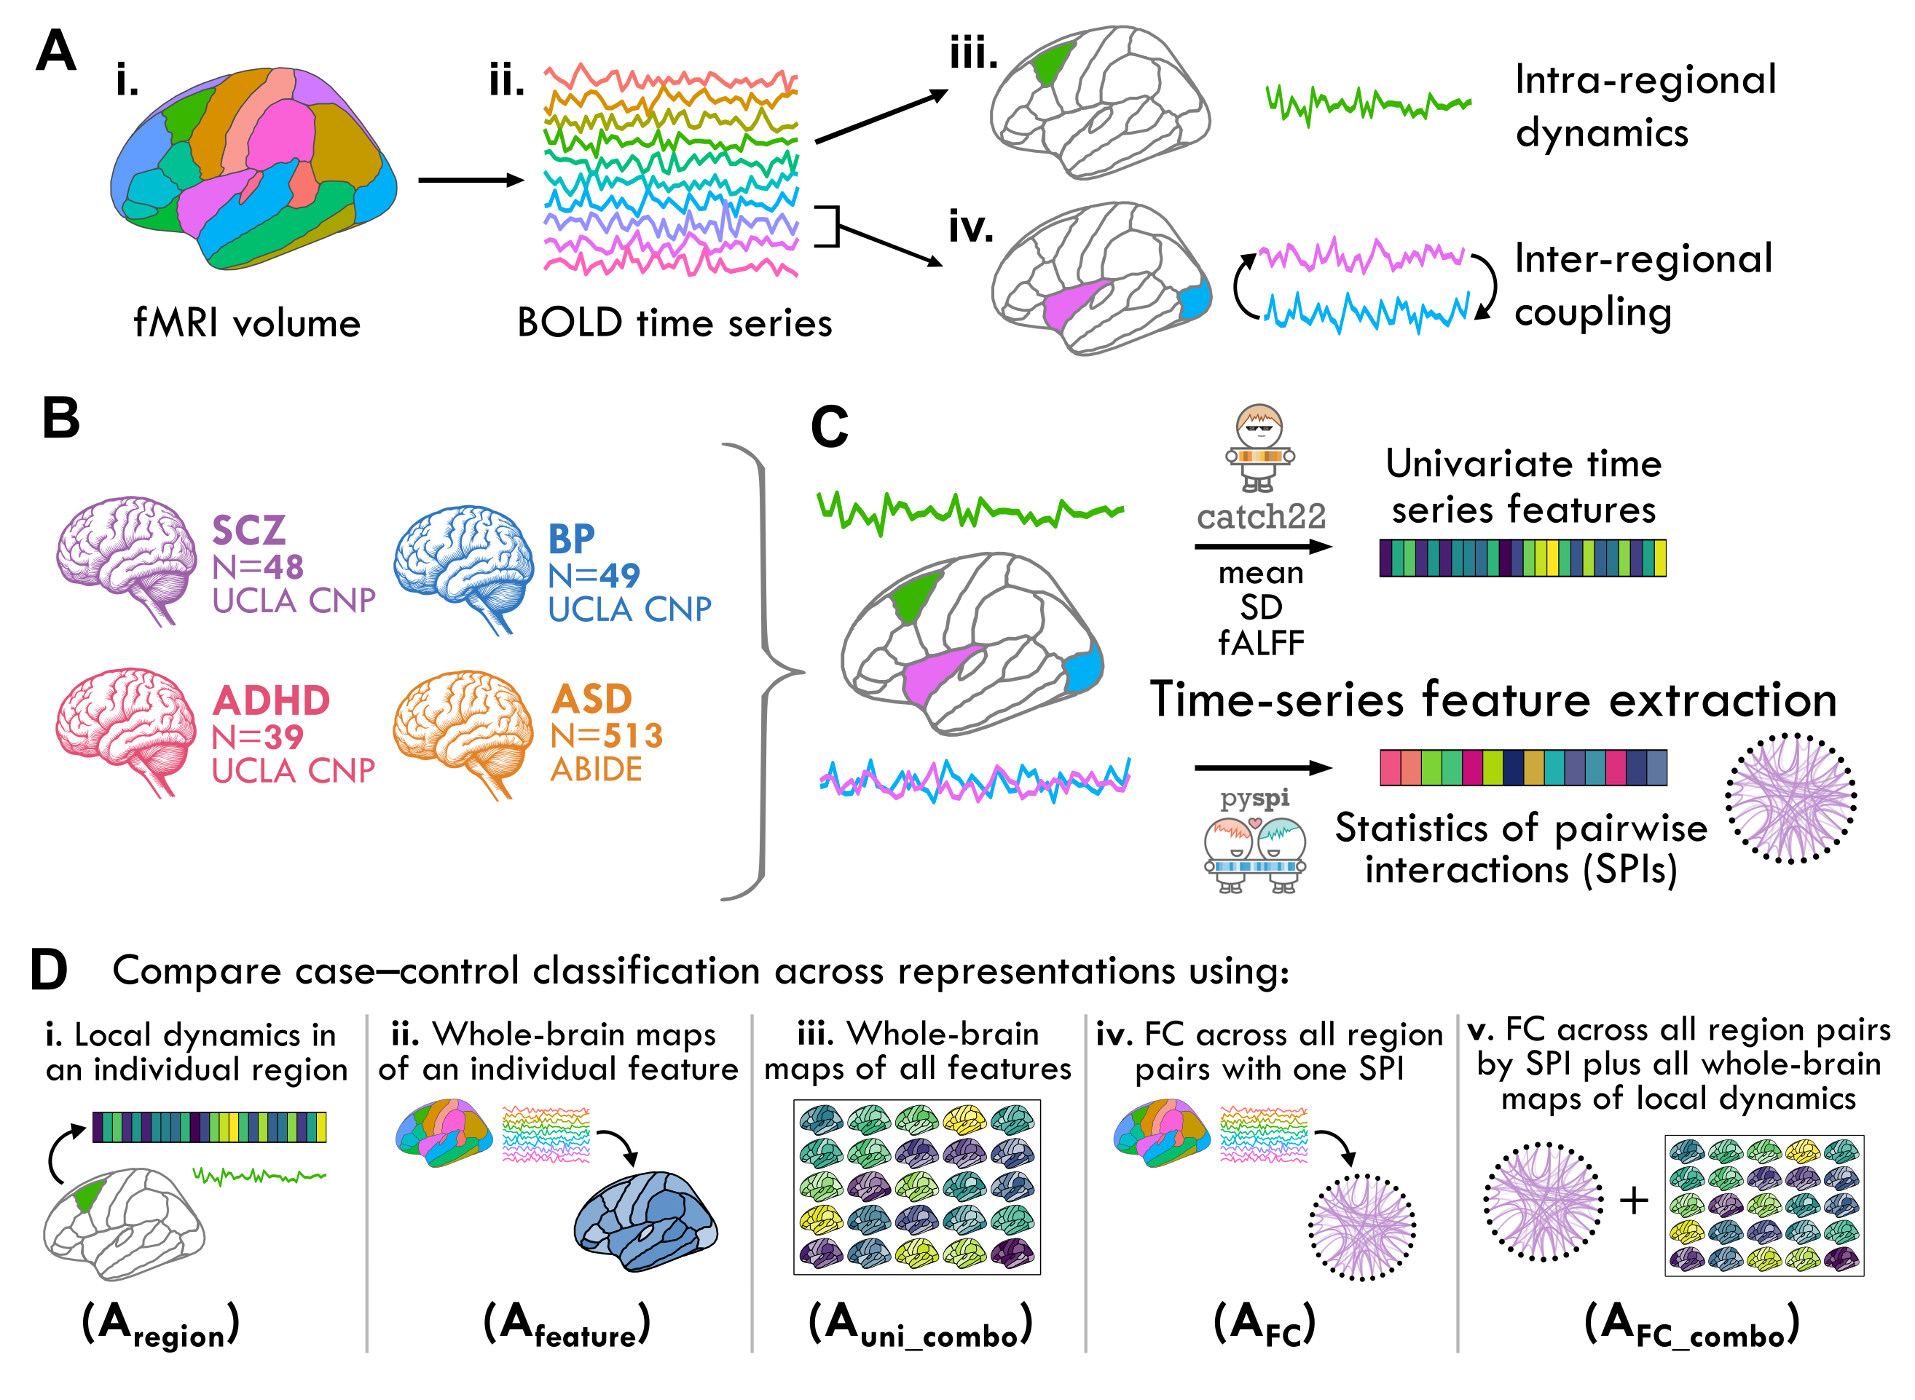
Fig 1

Slide 2
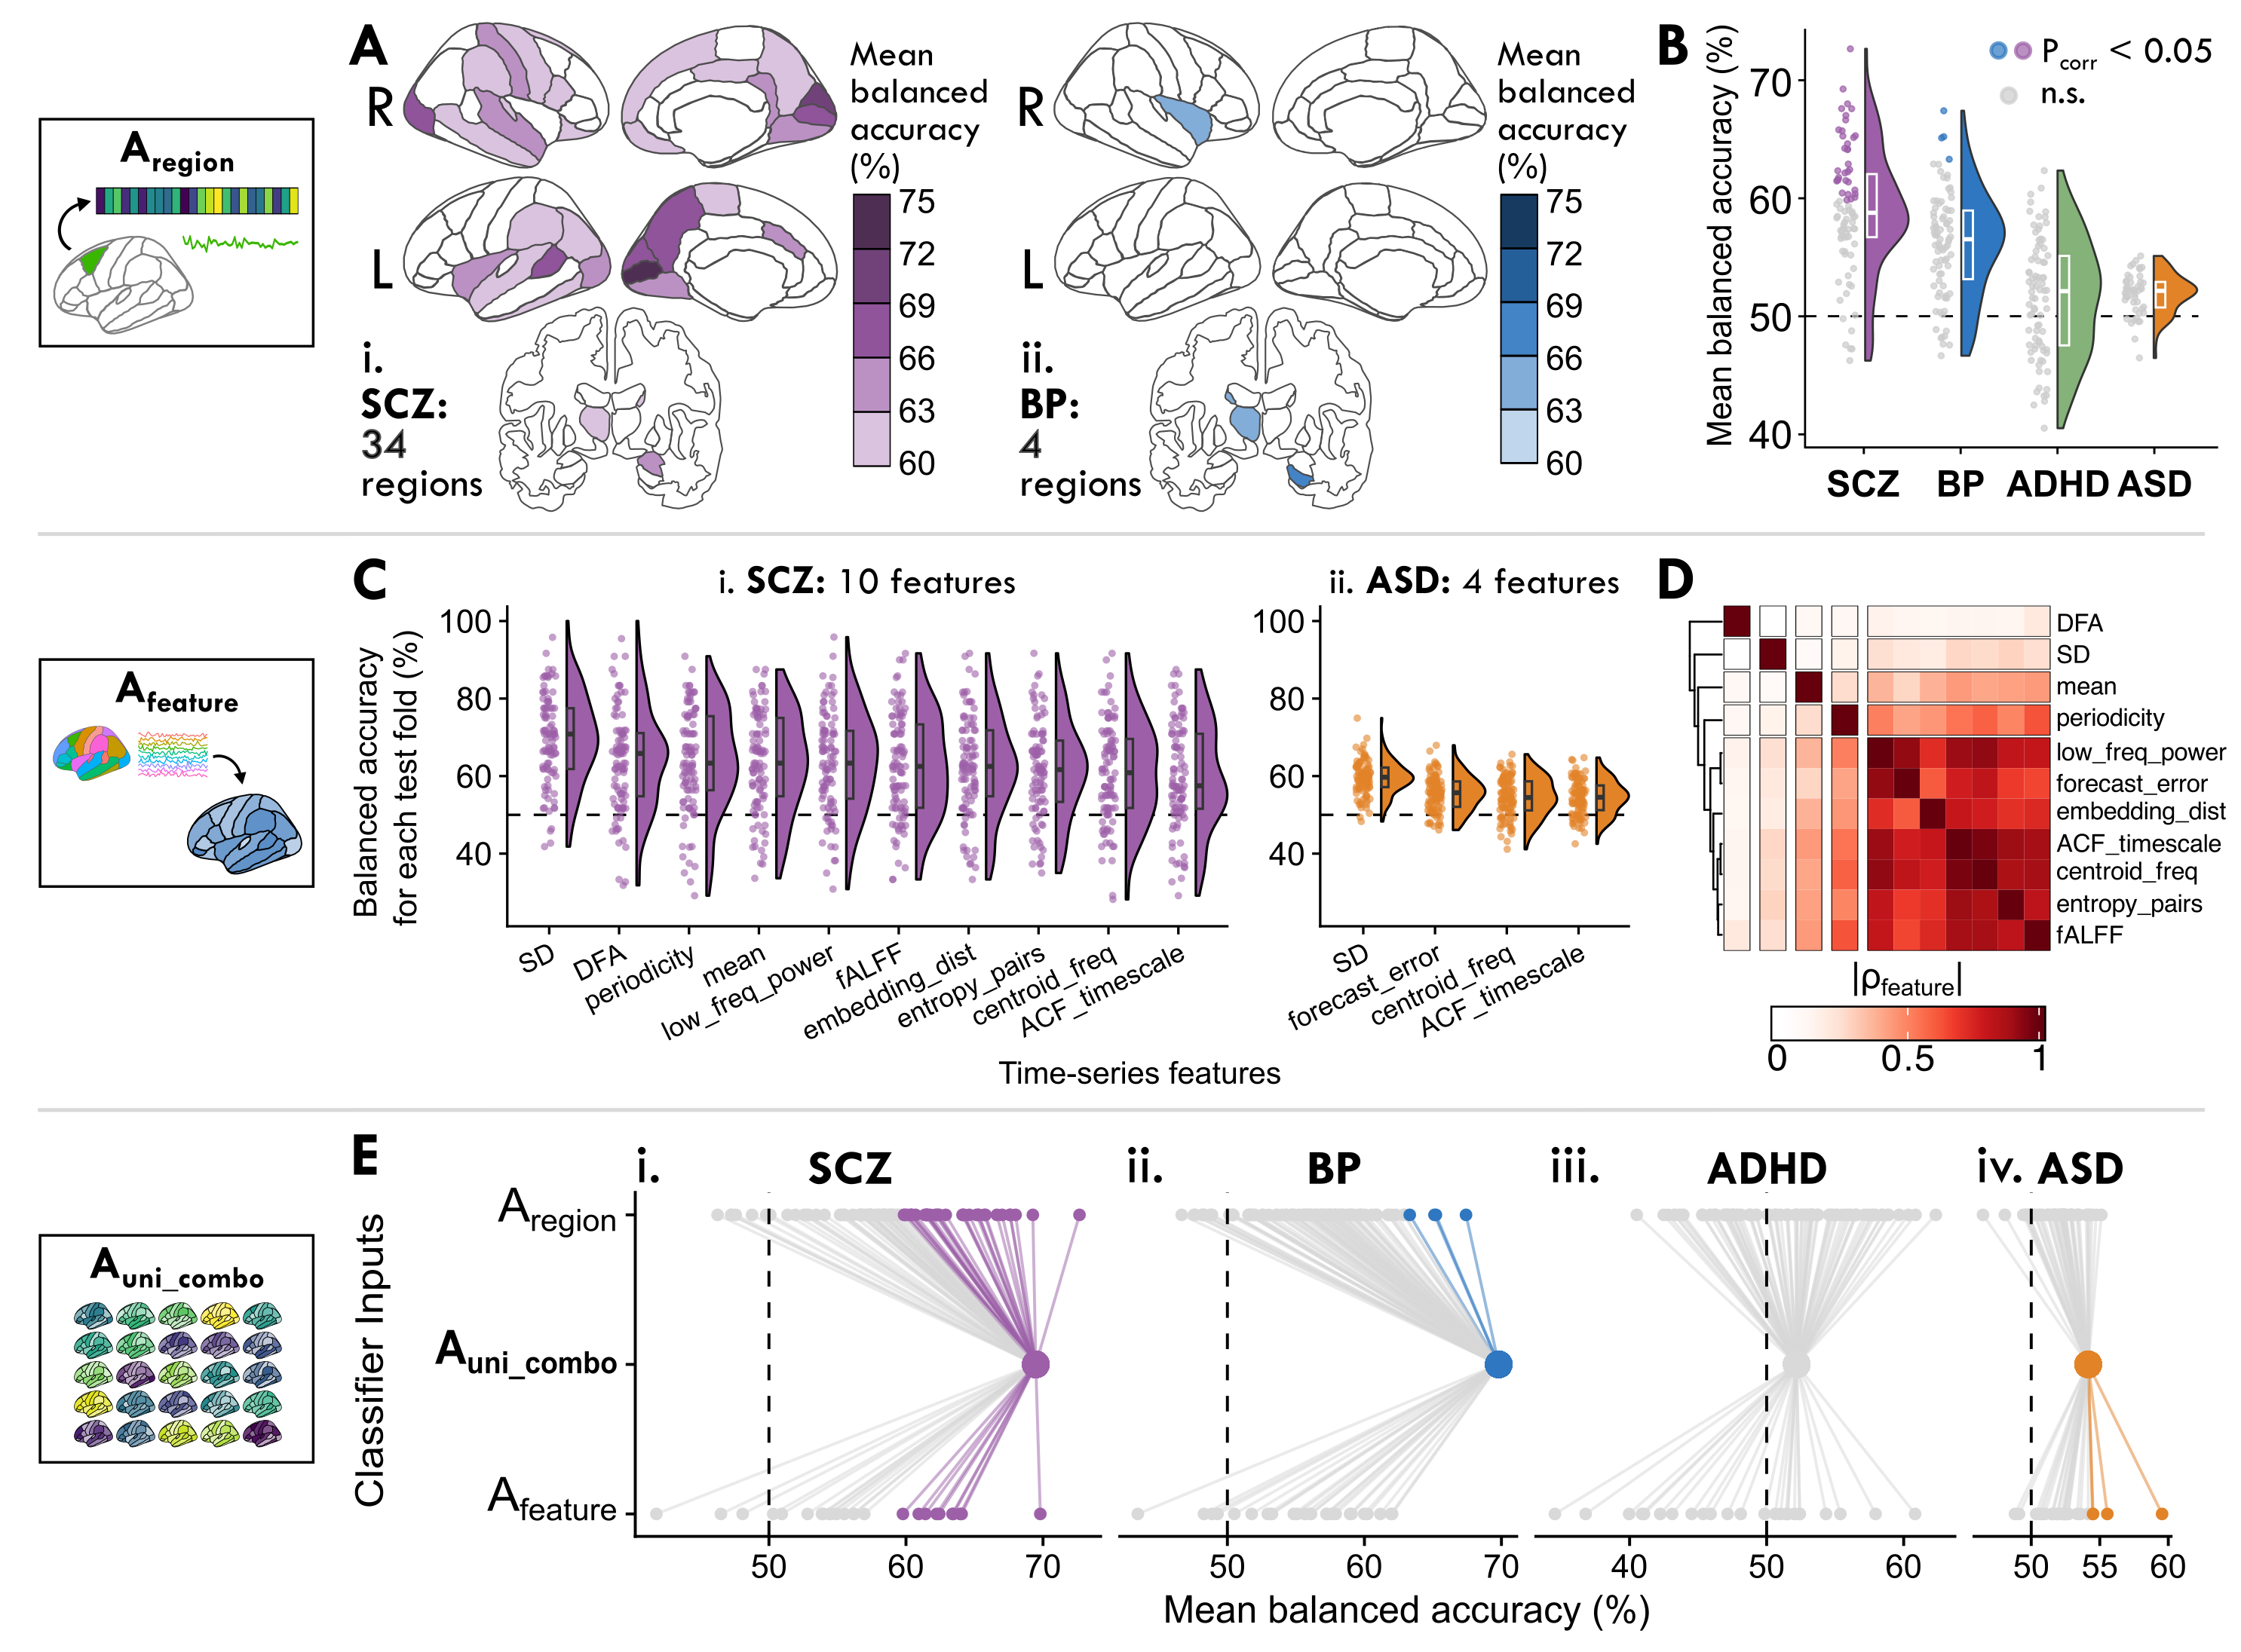
Fig 2

Slide 3
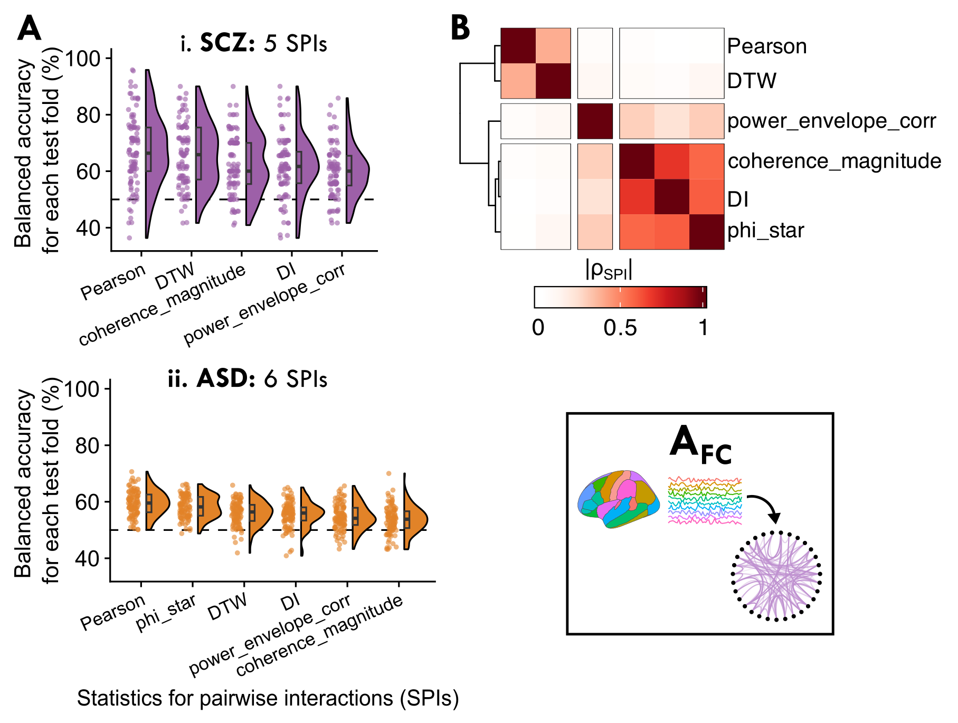
Fig 3

Slide 4
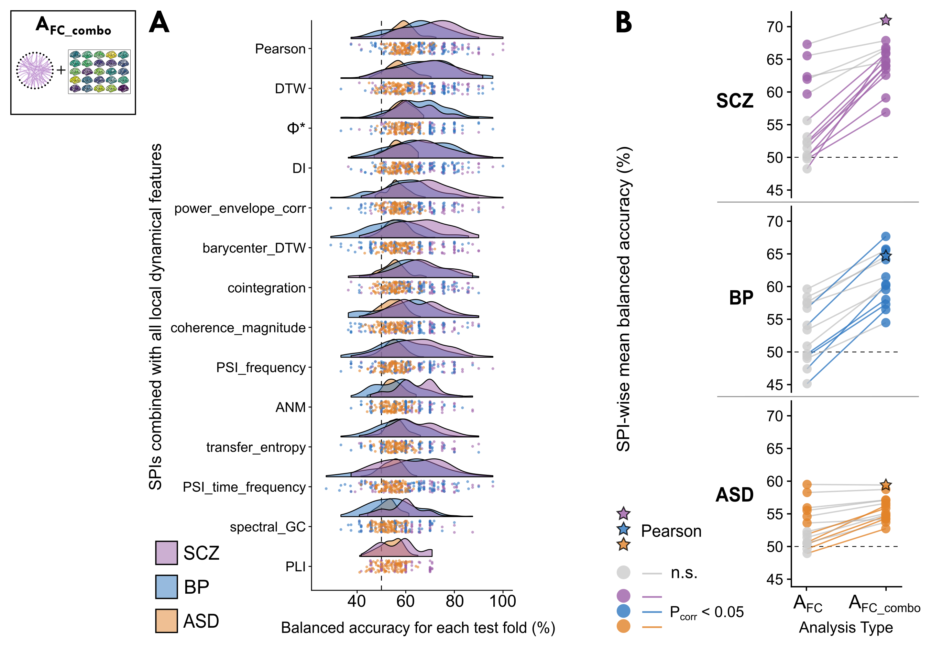
Fig 4

Slide 5
Fig 5 ?

Slide 6
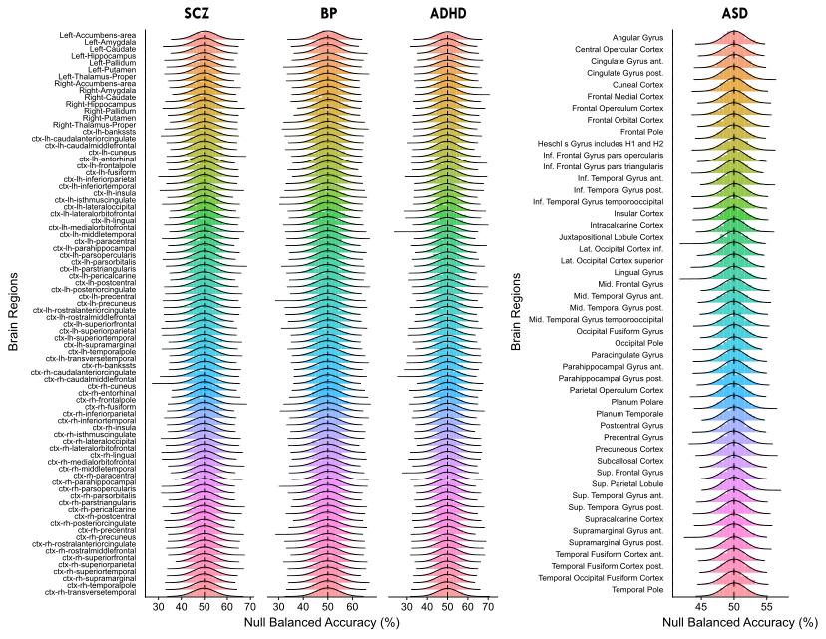
Fig S1

Slide 7
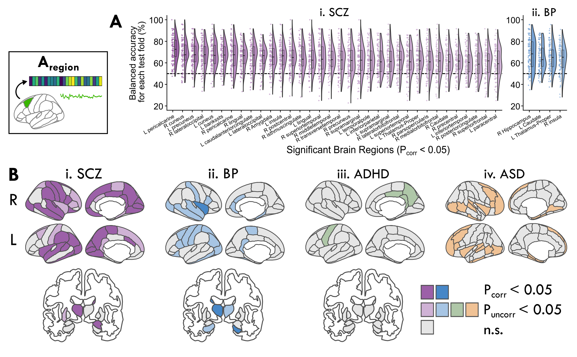
Fig S2

Slide 8
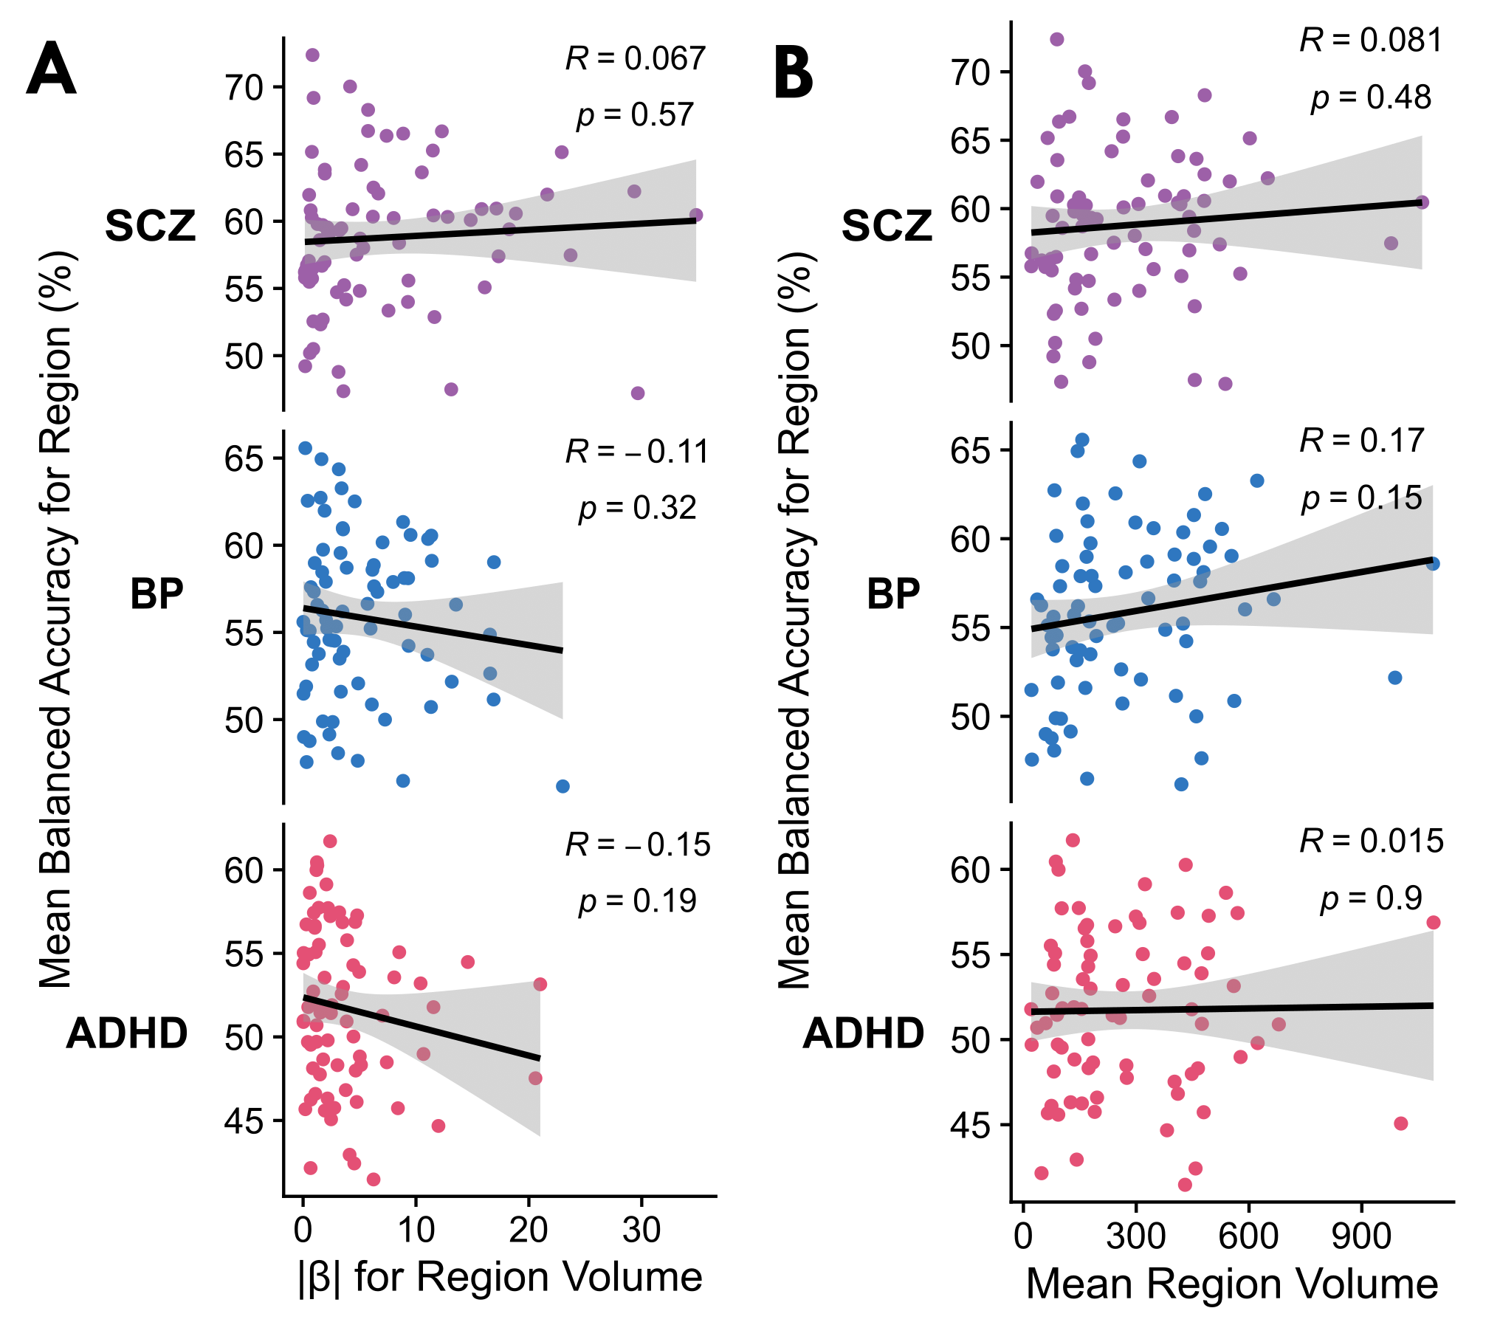
Fig S3

Slide 9
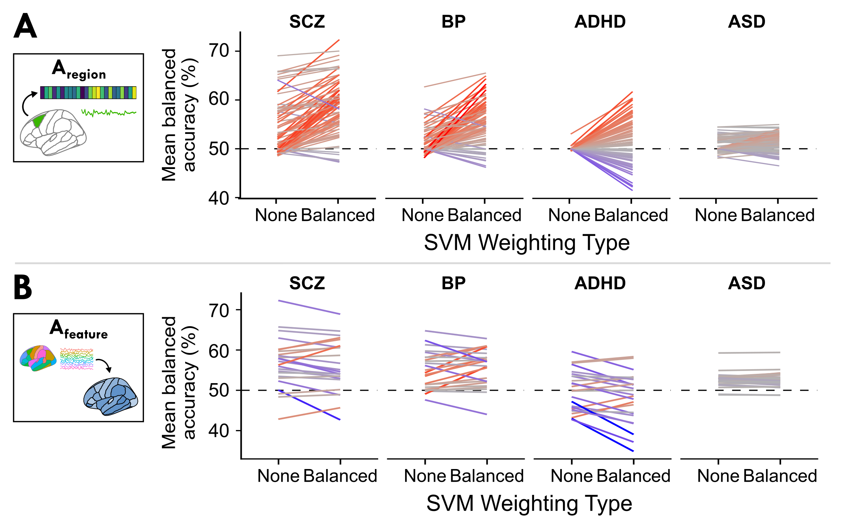
Fig S4

Slide 10
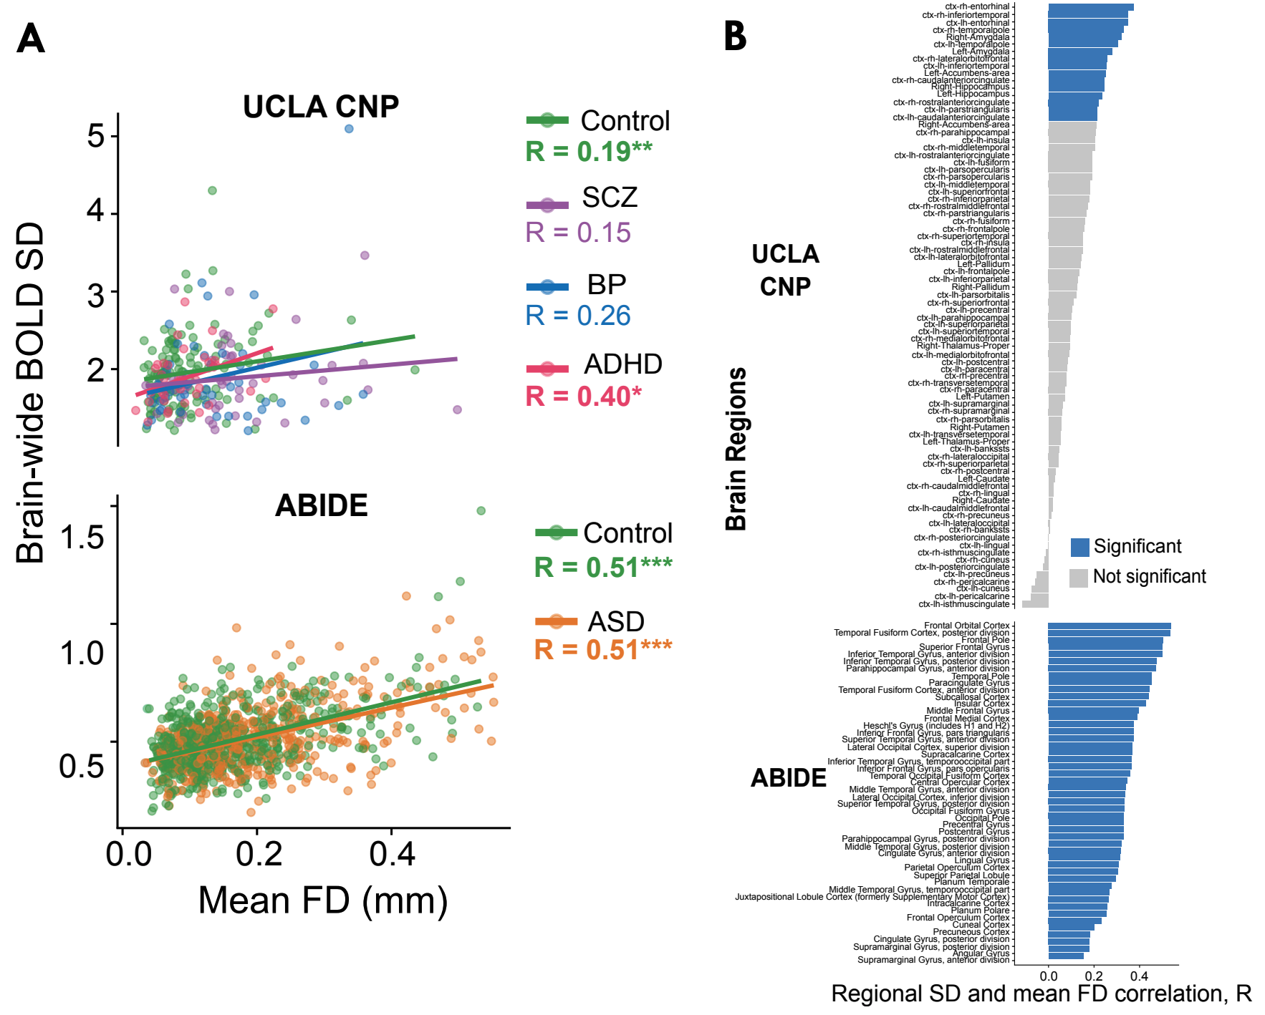
Fig S5
To update with more in-depth confound analyses, such as a classifier trained on head movement + age + sex with versus without top region per disorder along with individual-site classification with ABIDE ASD

Slide 11
Fig S6
To update with general classifier robustness analyses that compare 1. nested CV vs regular CV, and
2. classifier type

Slide 12
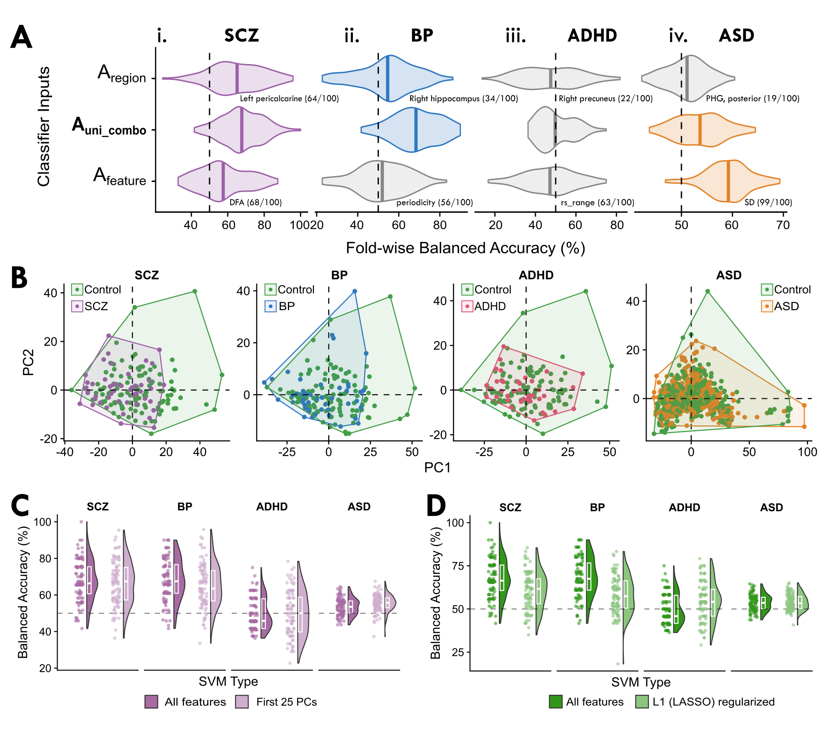
Fig S7
To update with more univariate combo-specific robustness analyses that compare:
1. All features vs. first 25 PCs,
2. Regular SVM vs L1-regularized

Slide 13
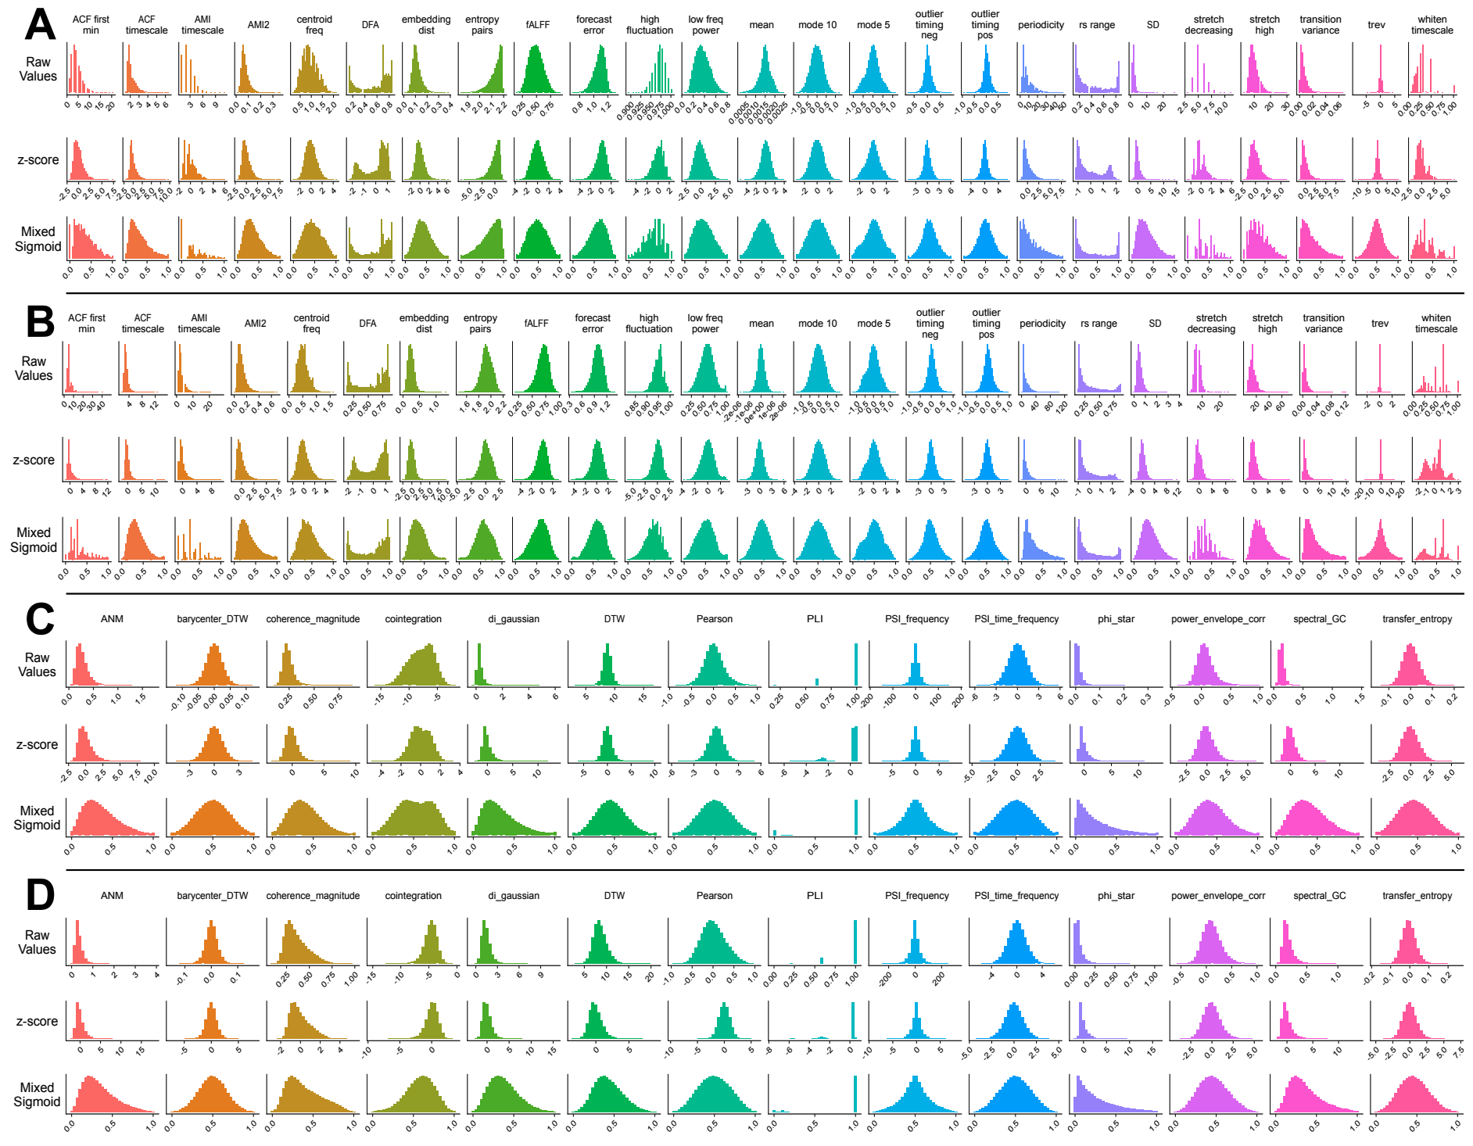
Fig S8

